Slide 1


Slide 1
CAFÉ CHILL!
SINDHU THOKALA

Slide 2

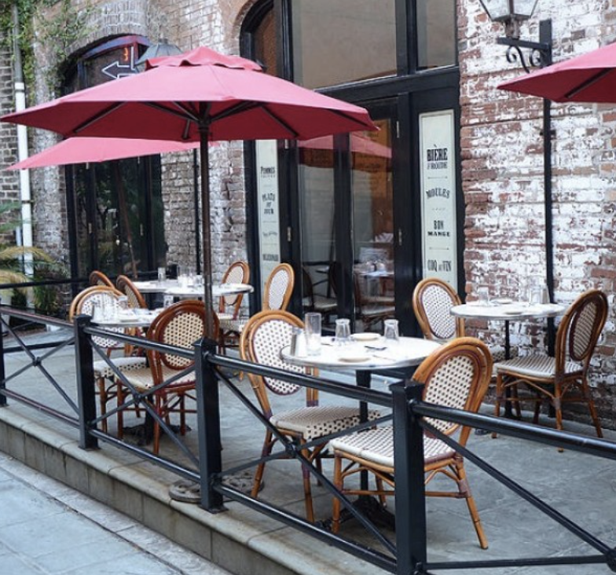

Slide 2
MY BIG IDEA
Café Chill! Has only one mission and that is to bring the European coffee shop – the balance of city bustle and relaxation to the heart of New York City.

Slide 3

Slide 3
Introduction
The modern-day café provides the perfect ambiance for people to come in and enjoy a slow-paced life style, whether it’s to have a conversation, get some reading done, or to just sip of a latte, the café helps to provide the escape. New York City, although, has its plethora of coffee shops, it lacks the cafe and introducing it to this bustling city could help bring the balance of busy and leisure.

Slide 4

Slide 4
Problem
New York City is a crowded city with several Patisseries and coffee shops however, identifying if they have the café setting is an important aspect. And spotting where the café could be effectively located is also a significant aspect, because it needs to draw the crowds of the city for an unwinding experience.

Slide 5


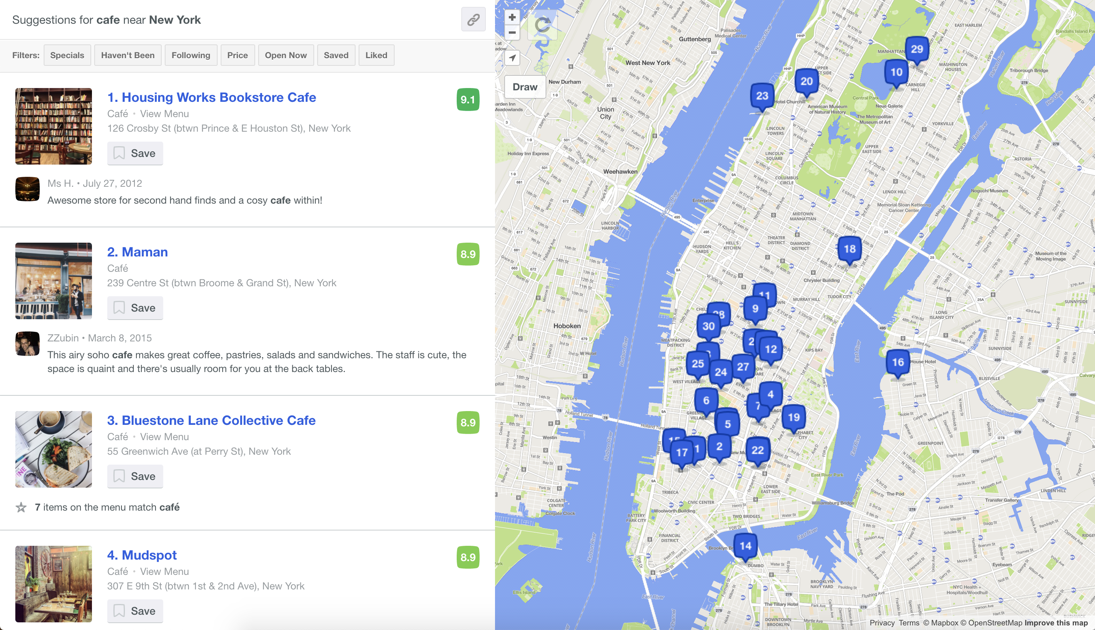

Slide 5
Solution
Foursquare API

Slide 6

Slide 6
Methodology
Hone in on the coordinates for potential café location
Use Foursquare to determine similar enterprises near by
Cluster the business to find possible location

Slide 7
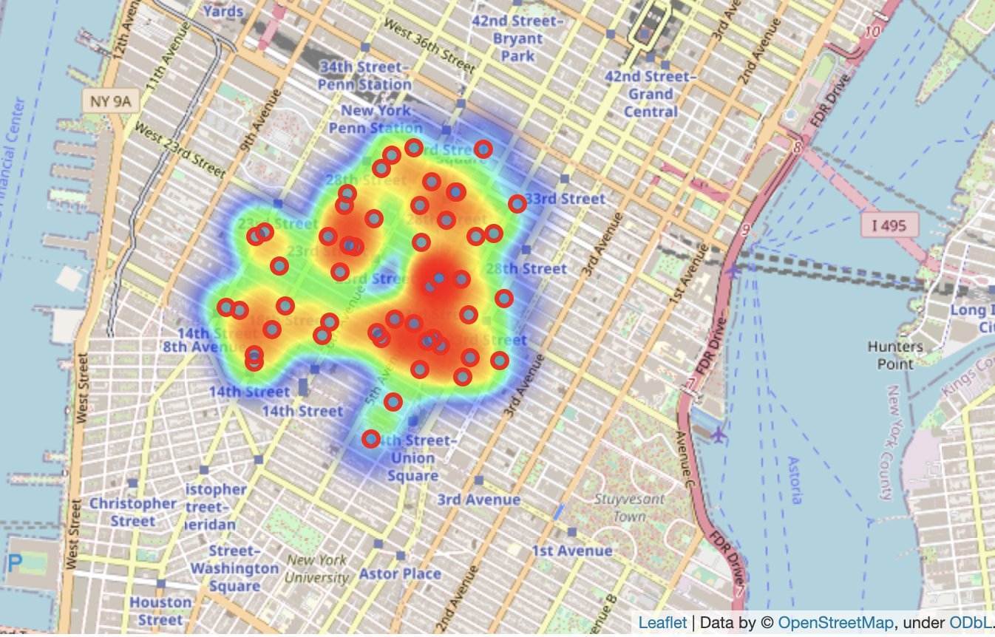
Slide 7
HEAT MAP – COFFEE SHOPS AND EATERIES

Slide 8
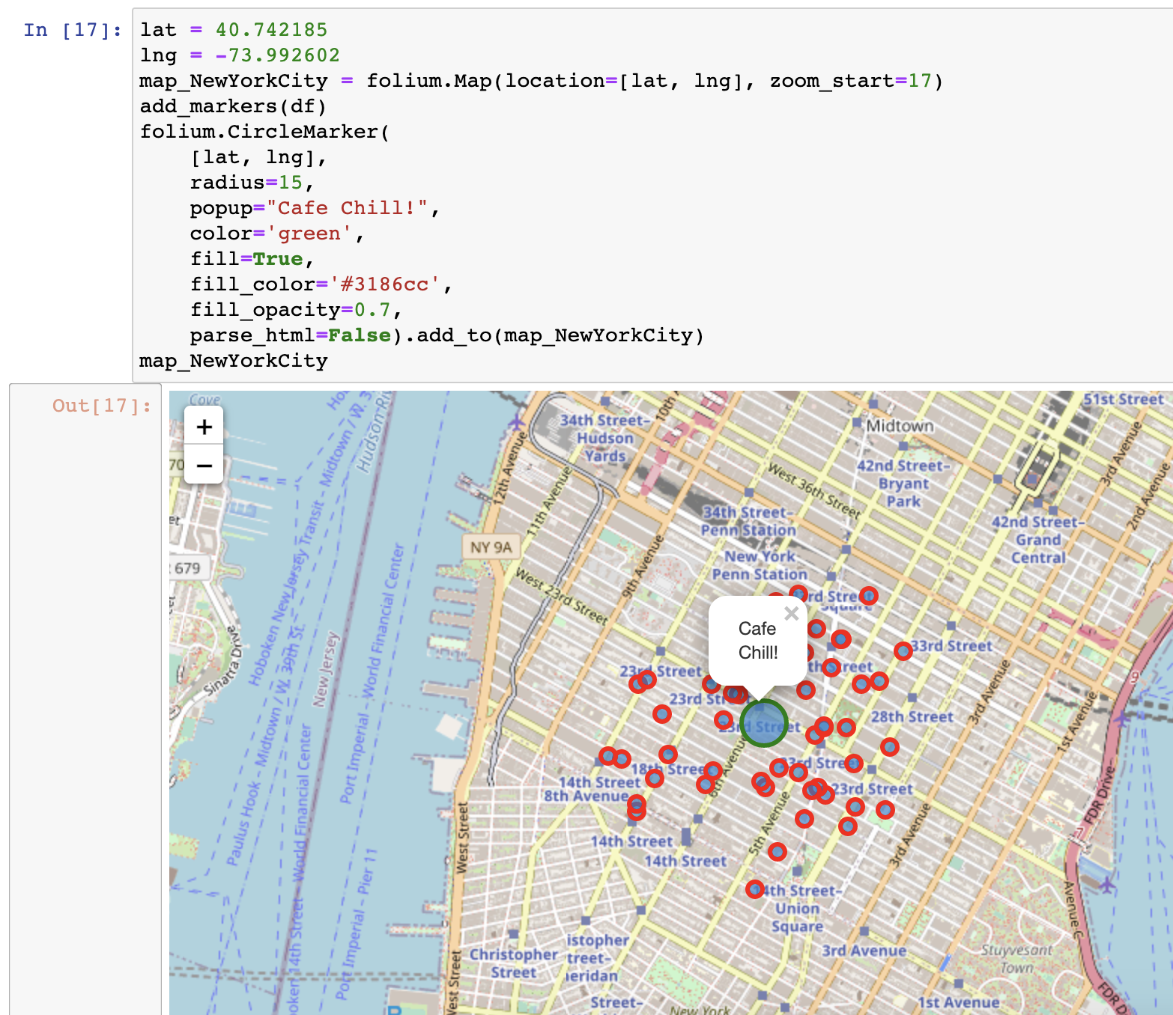
Slide 8
RESULTS

Slide 9
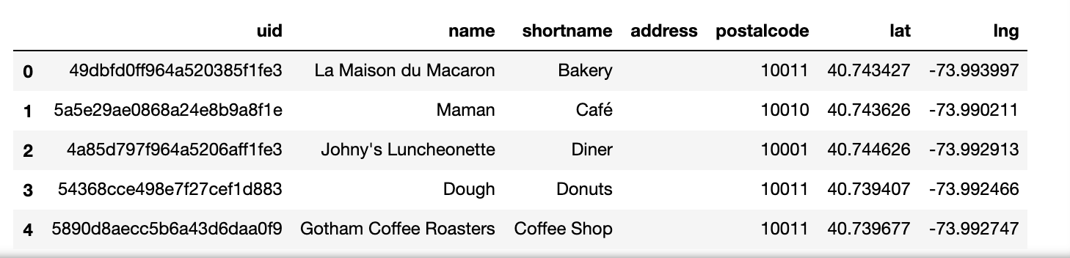
Slide 9
RESULTS - ANALYSIS
After determining the similar places around the area with the help of df.head() code snippet below and the heat map provided above, the possible location for the new site was able to be seen.

Slide 10

Slide 10
DISCUSSION – AFTER THOUGHTS
As someone that has worked in New York City in the particular location where the plethora of coffee shops and eateries appear, I longed for a café. A place where I can sit, have a sip of coffee, a bite to eat, and most importantly unwind after a long, arduous day. Although, there were some cafes they were not as readily available nor do they provide the experience as I had stated before, that the European cities are widely famous for, their cafes to unwind at.

Slide 11
Slide 11
CONCLUSION
Having a map and walking around New York City to scout out all the possible café locations are one thing, however for a business person to be able to determine a potential café that can be established in the heart of New York would be a challenge but also a rewarding experience. Having the right tools such as Foursquare API for the data as well as the visual tools to help bring to life the clustering methods, and algorithms helped to create a rewarding experience throughout this project.

Slide 12

Slide 15
THANK YOU!
Images: Courtesy of Google

